Slide 1
Myths regarding AI in the Society.
Pravin Vedurla

Slide 2
*grain of salt*

Slide 3
Questions?
Relax and have fun.

Slide 4
Myth_1:
AI is a one stop solution to literally every single problem out there.

Slide 5
No,
At Least not with the technology and computation power we have at this moment.
Notes:
Change color

Slide 6
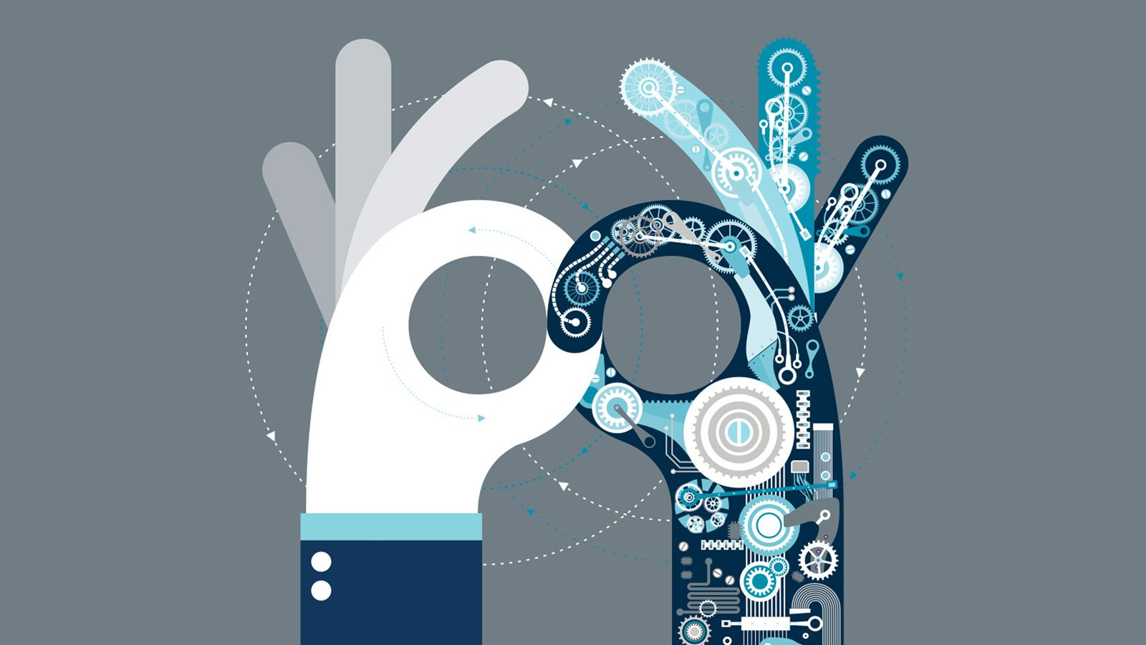
AI models are usually trained upon existing Data.
So, An AI can only solve problems that it has trained on, Hence it has a huge advantage over Automation.

Slide 7
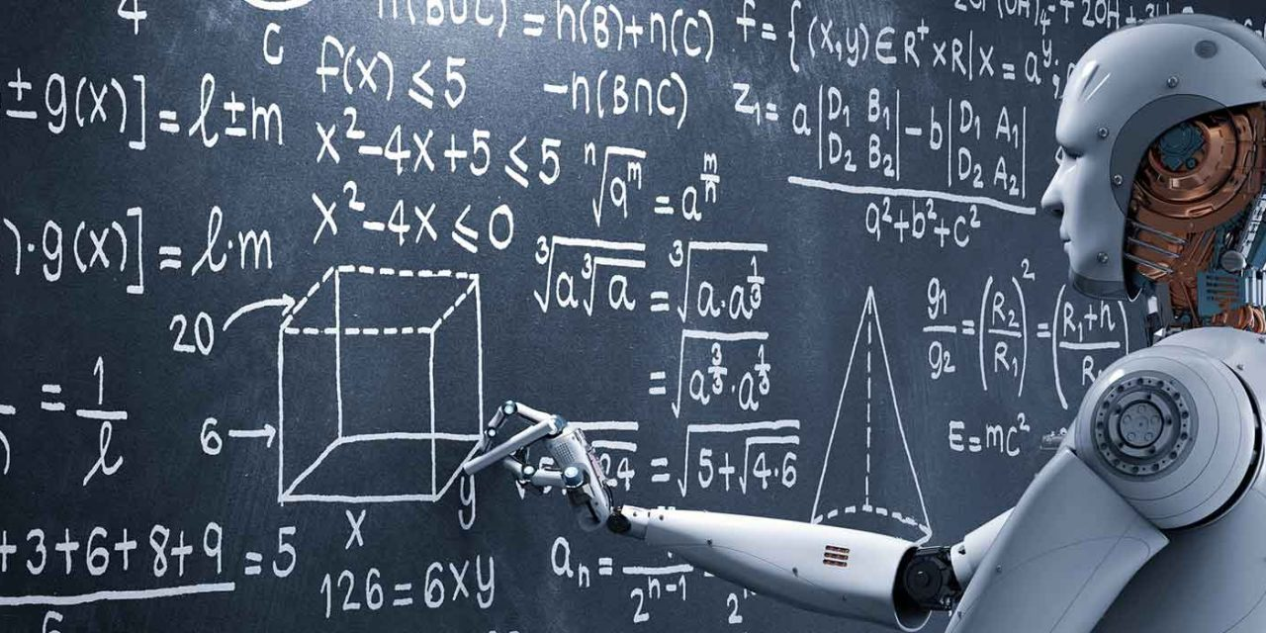
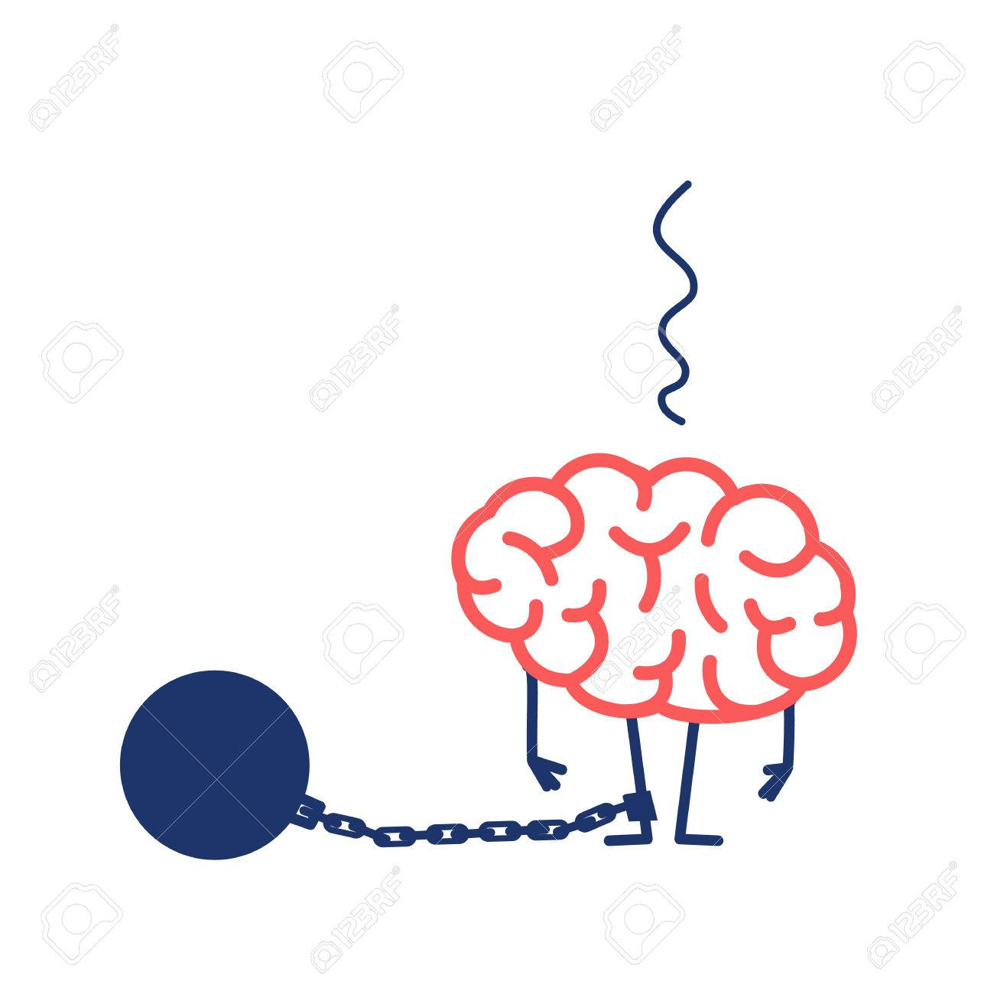
Look at it in a different Angle.
AI might provide a new perspective towards problem solving.
An average human brain is restricted as compared to 2.8 billion operations per second ( single core computer) at our disposal.
200 quadrillion calculations ps (Supercomputer)
Google’s Colab is public and offers free GPU power for each and every individual.

Slide 8
Myth_2:
AI will take up most of the Human Jobs in the mere future.

Slide 9
Yes,
AI has reached an automation level to replace most of the repetitive human jobs.

Slide 10
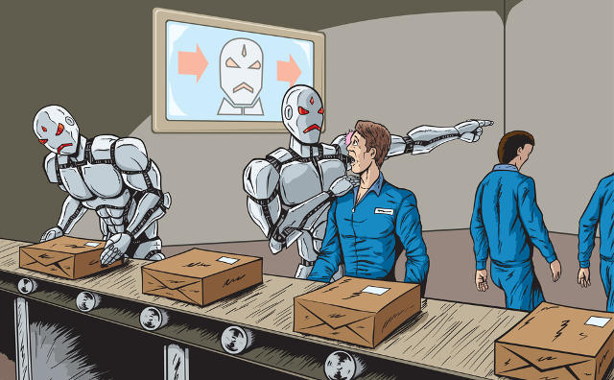
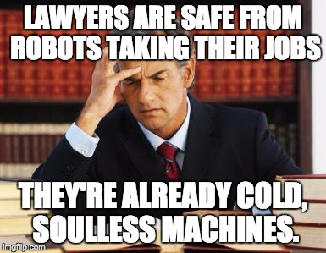
A New Dawn
Most of the human level job that contain patterns in the work routine are threatened to be replaced by AI.
We have site that determines your job - https://willrobotstakemyjob.com/

Slide 11
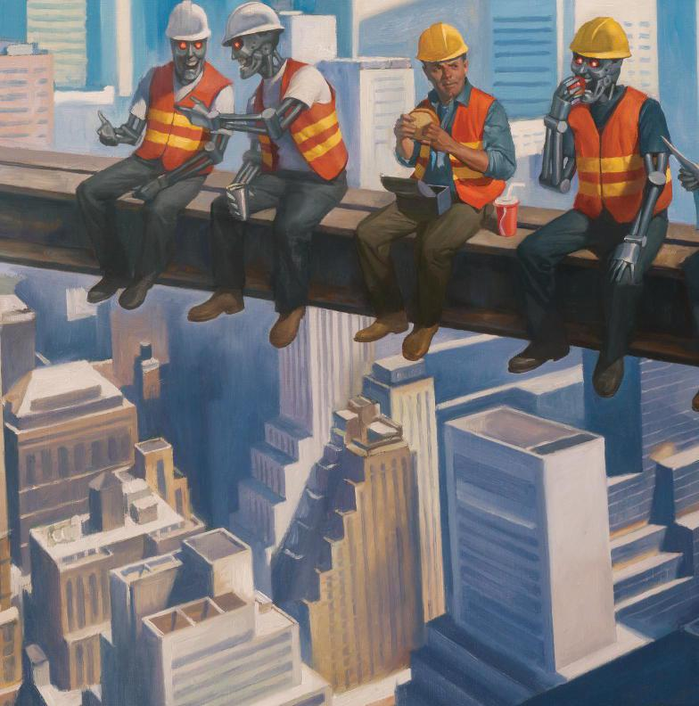
Who is safe here?
Human conscious and cognition is still ‘Human’.
An Artist and an Engineer are still ‘safe’ as they require imagination.
New jobs such as ML engineers, Automation experts are blooming and are expected to be irreplaceable.
In a different perspective, We’re better off replacing robots with people working in unsafe environment.

Slide 12


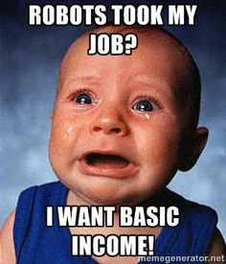

Basic Income ( Welfare )
Everyone gets paid regardless of their working status and contribution.
Because of low percentage of jobs available.
Swedish and the Swiss are getting away with this concept for years now.

Slide 13
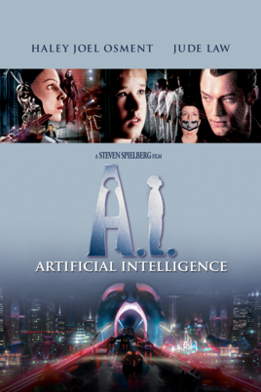

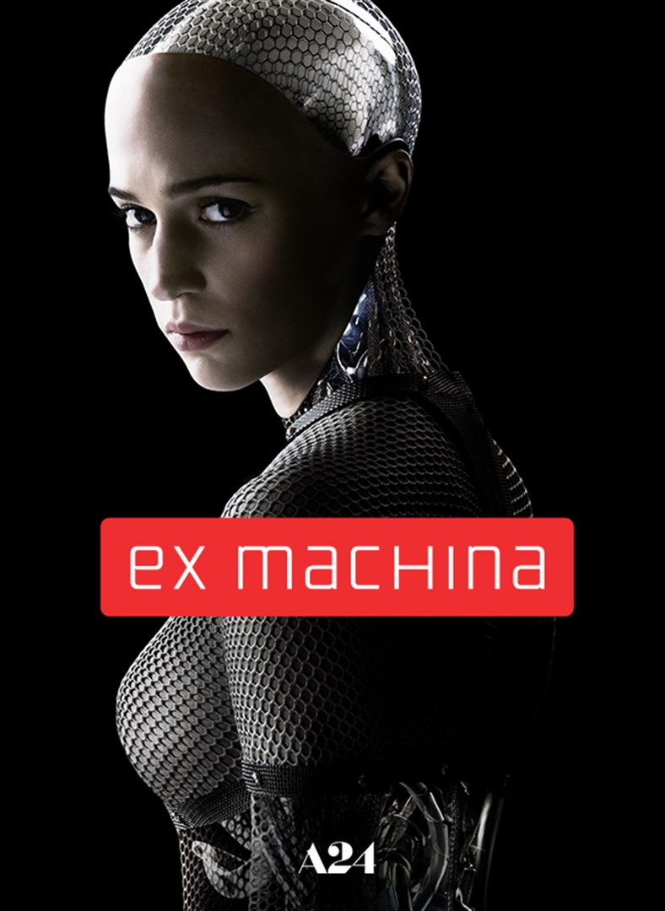
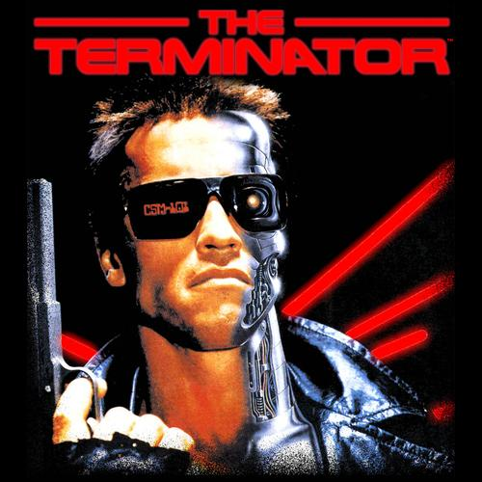

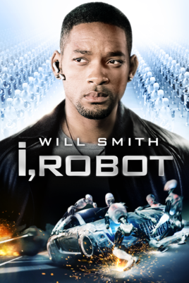
Myth_3:
AI at it highest form can threaten mere very human existence.

Slide 14
Maybe,
Provided, We develop AGI anytime sooner.

Slide 15
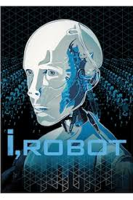
Artificial General Intelligence.
AGI is expected to have Human level Conscious hence gets self-aware.
Questioning Human necessity.
By-Laws
General rules that restrict AI’s awareness capacity.
Just watch I-Robot.
www.askskynet.com

Slide 16
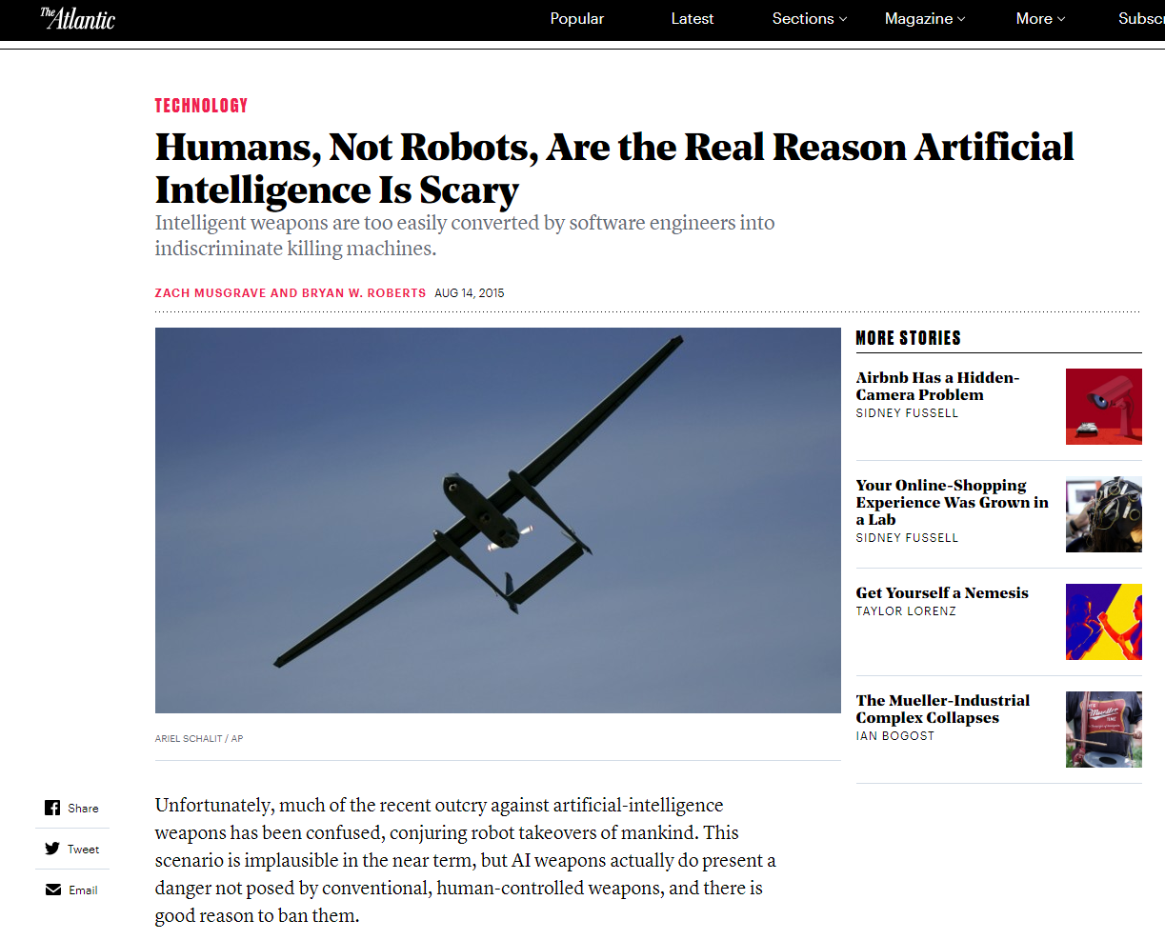
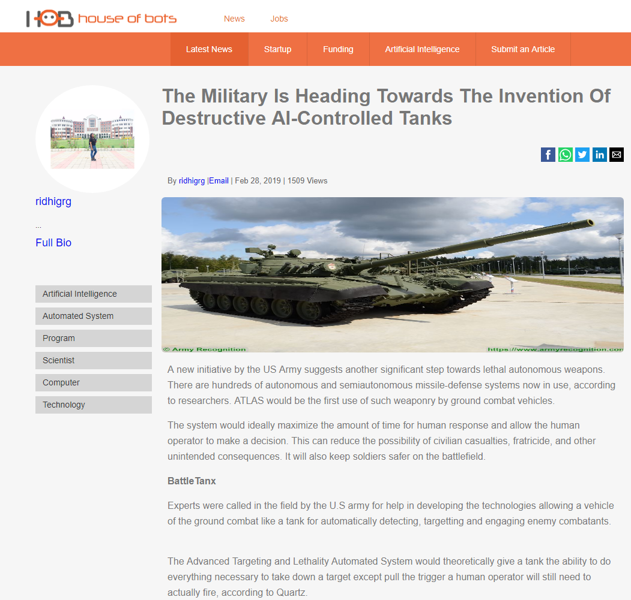
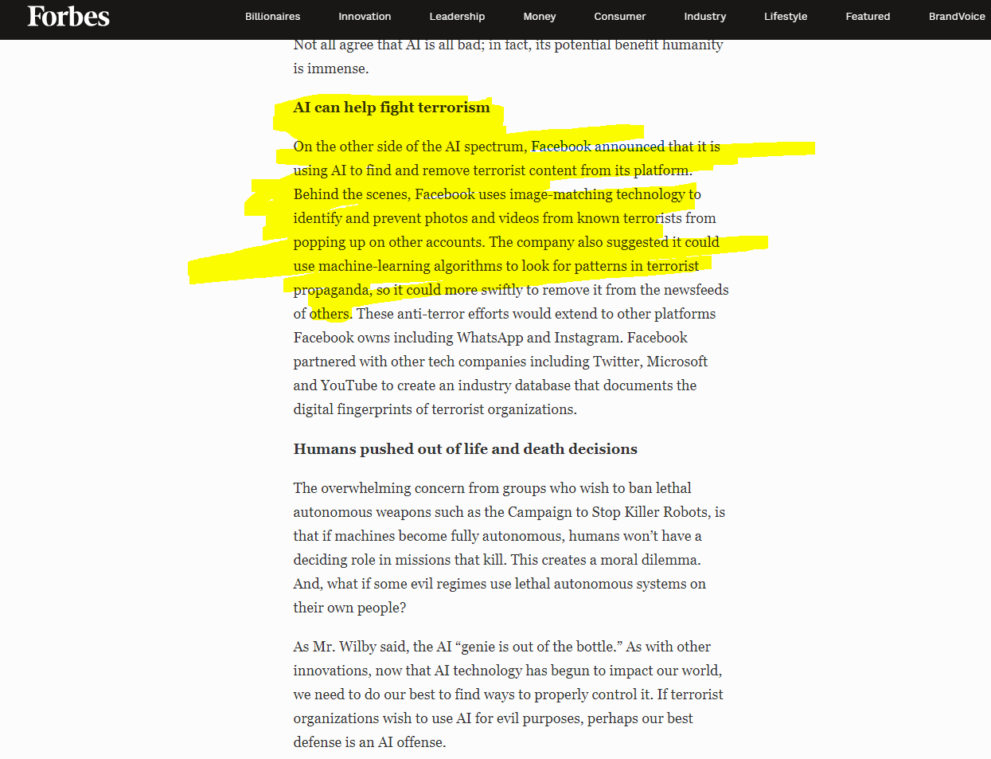
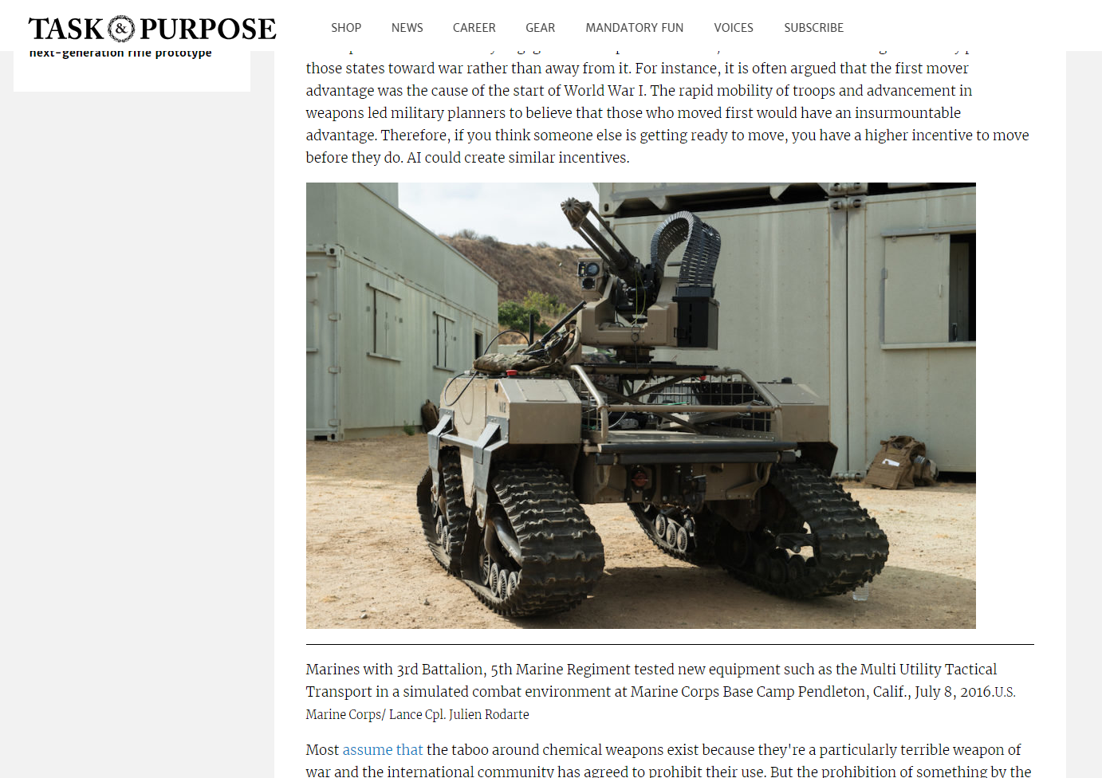
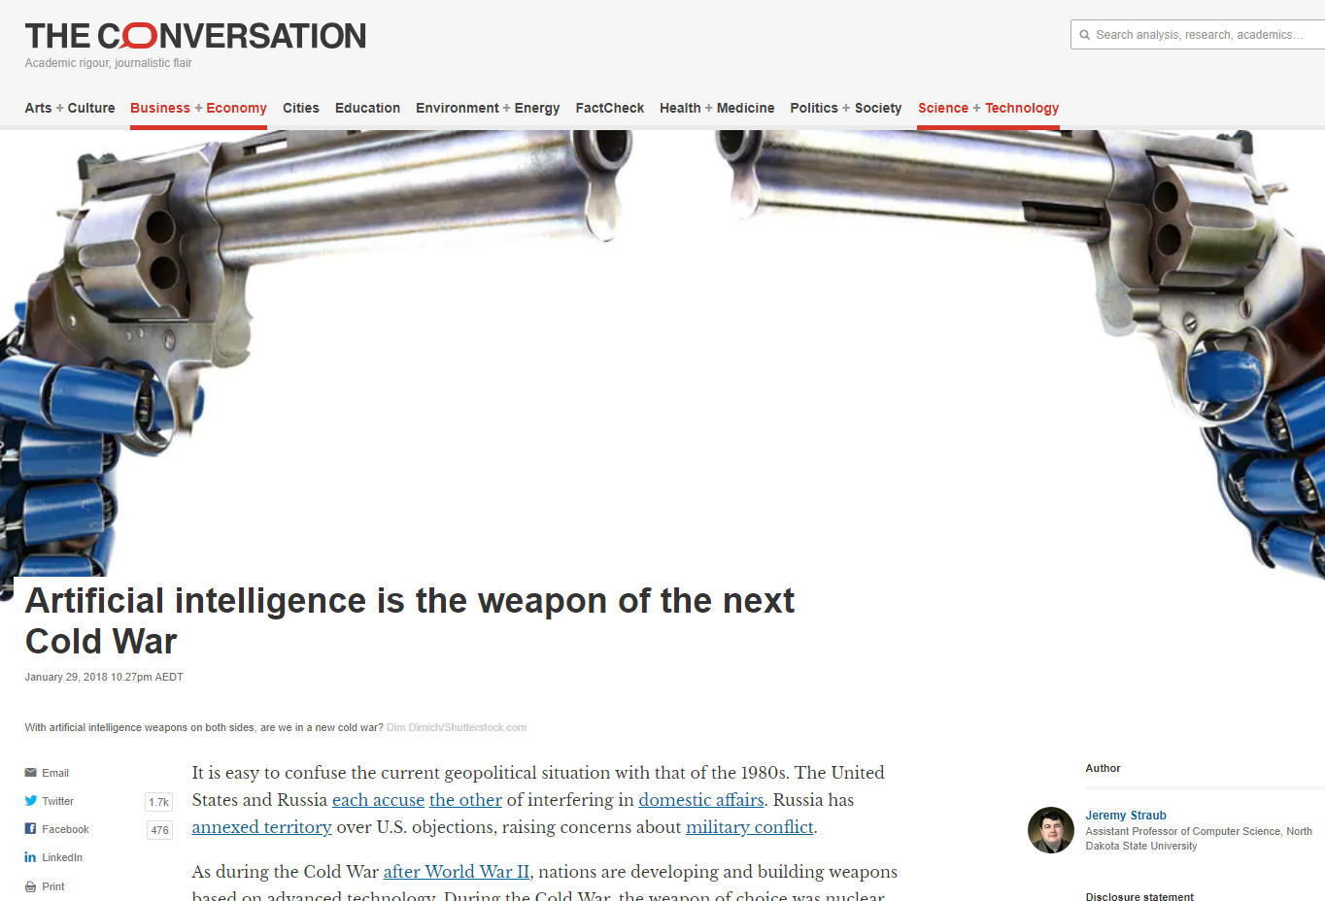
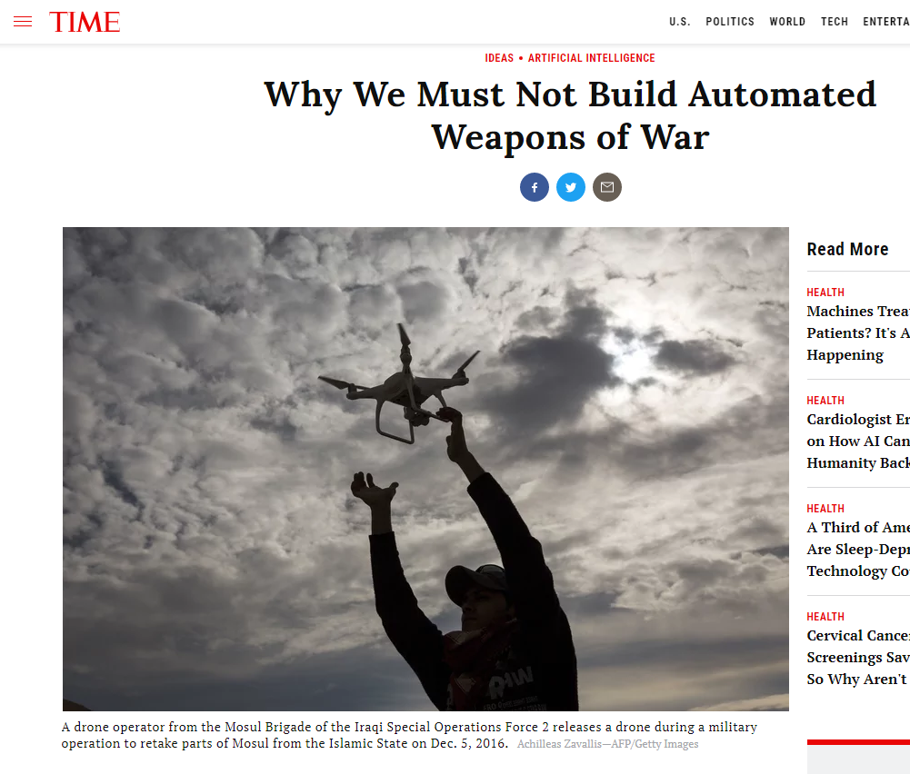
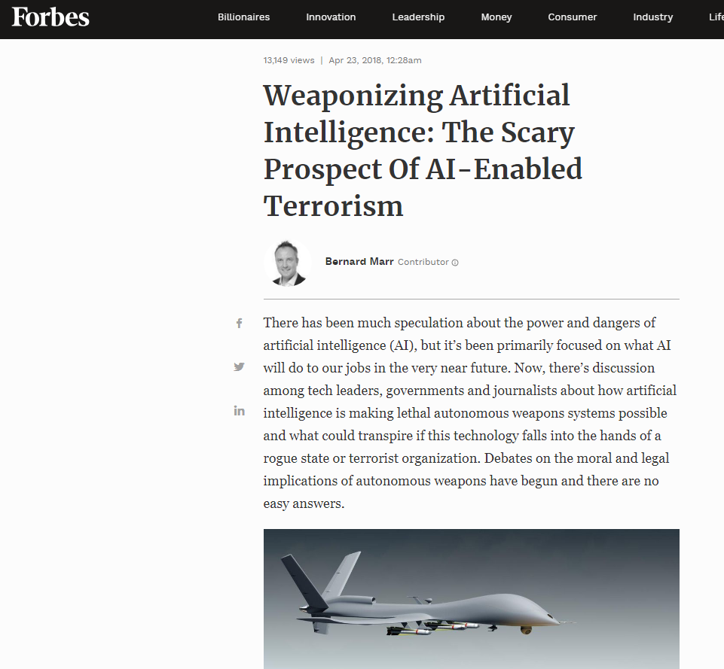
AI being used as a tool for destructive purposes.

Slide 17
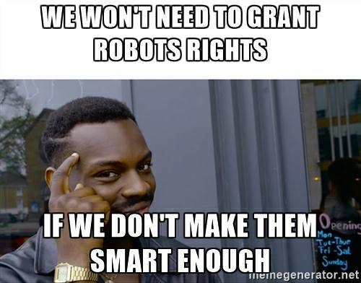
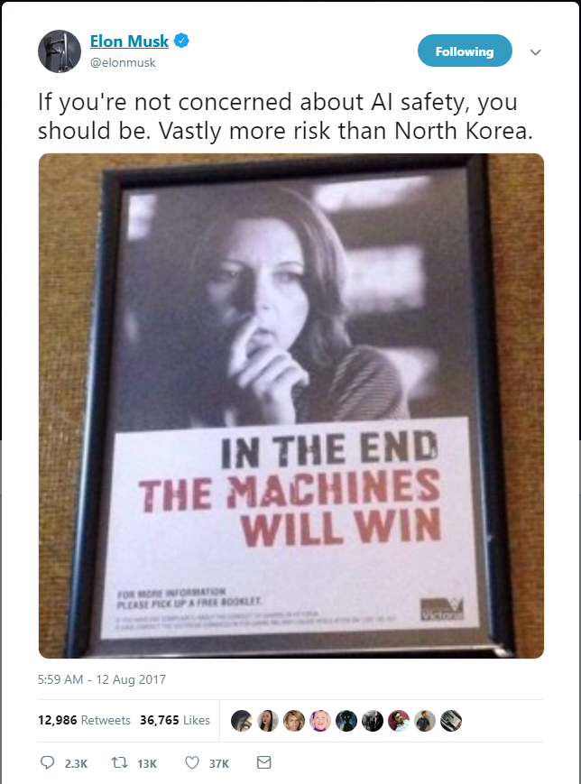
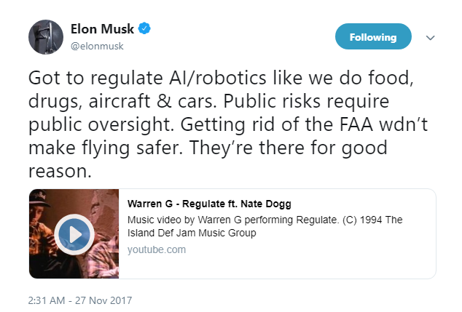
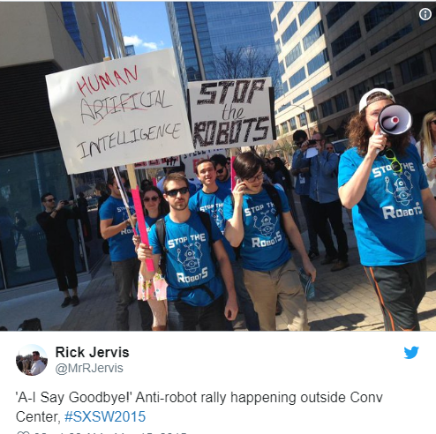
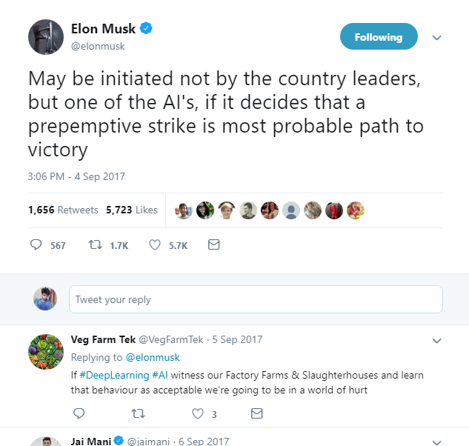
Activists ruling against AI development.

Slide 18
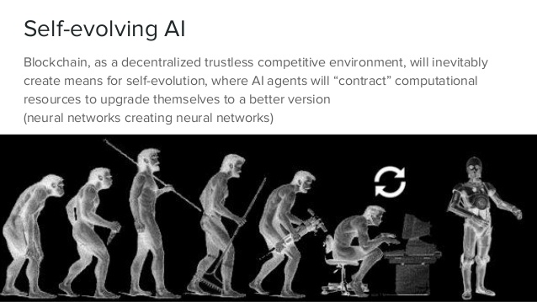
AI developers has a responsibility.
Siraj’s talk about Decentralised AI - https://youtu.be/GWOdAAFoSFE?t=525

Slide 19



Conclusion.
/pravin-vedurla
/pravinvedurla
/PravinVedurla

